Slide 1
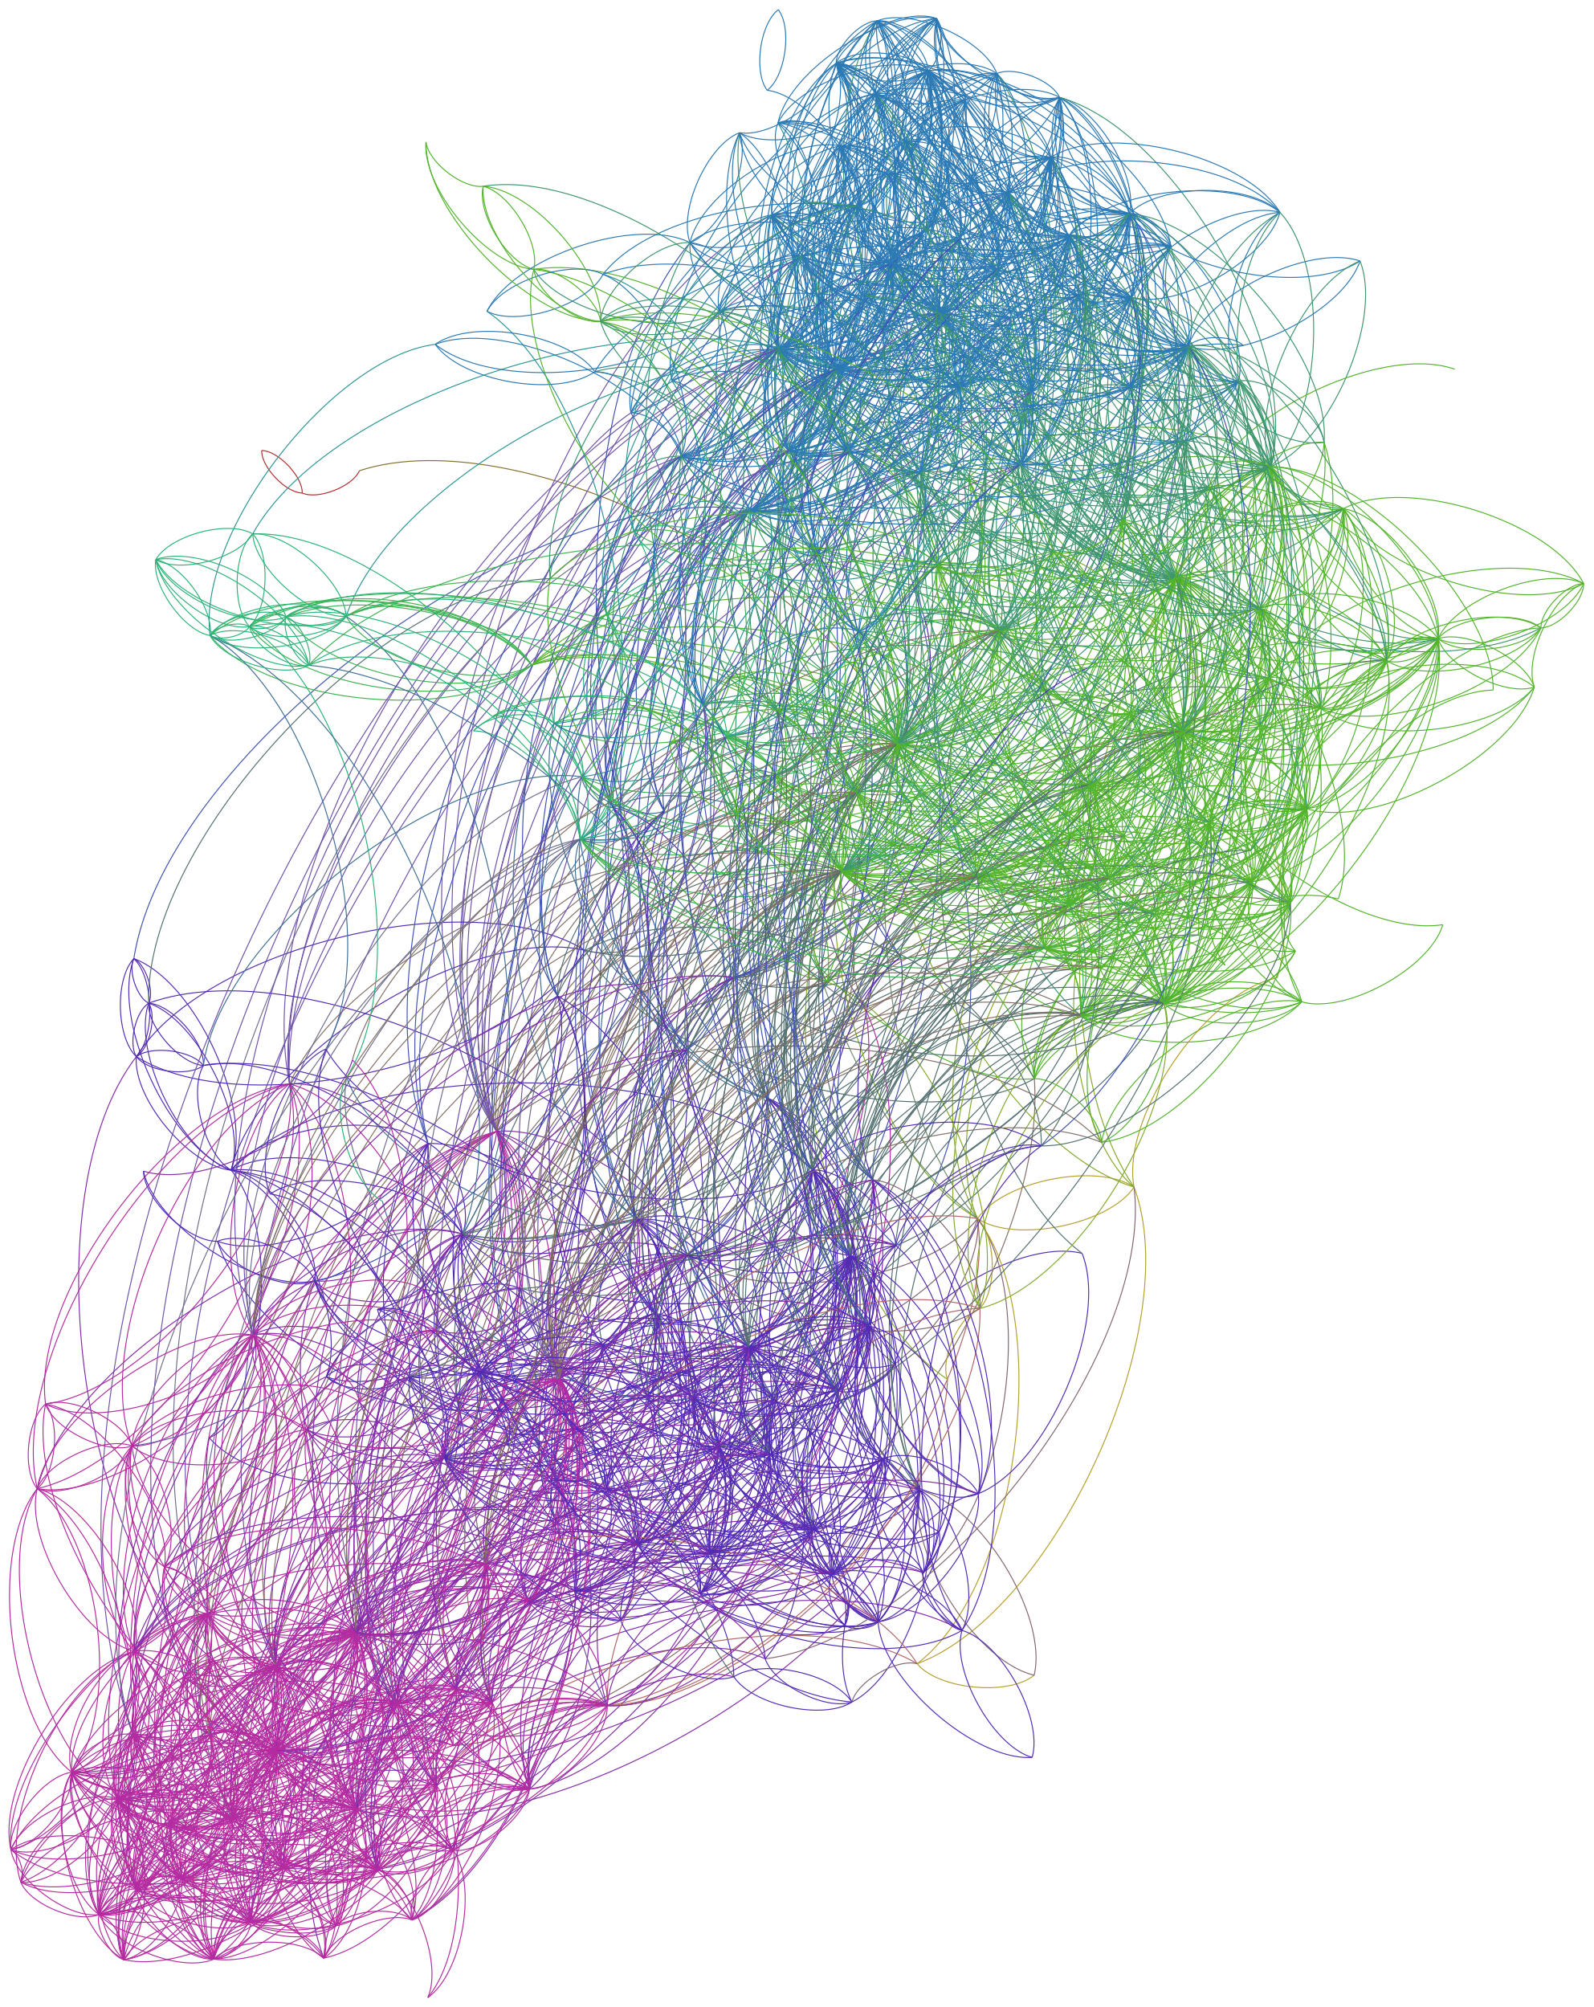
Fast Algorithms for Community Detection:
Louvain & Infomap
Chris Maria
Frontiers of Network Science, Fall 2021
Notes:
Image: Twitter Friends Network, C. Jones 2014: http://allthingsgraphed.com/2014/11/02/twitter-friends-network/

Slide 2
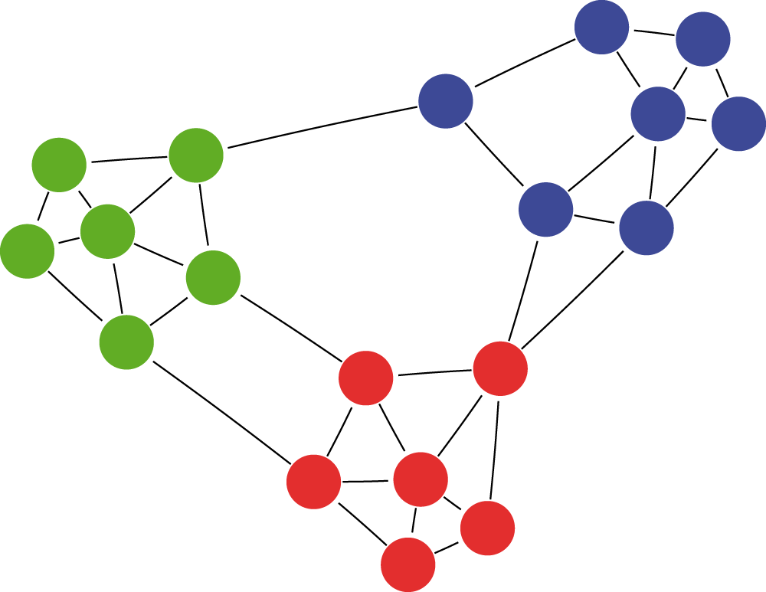
Community Detection
What is a community?
More internally connected than externally connected.
Countless applications!
Notes:
Image: T. Poisot 2013: https://f1000research.com/articles/2-130

Slide 3
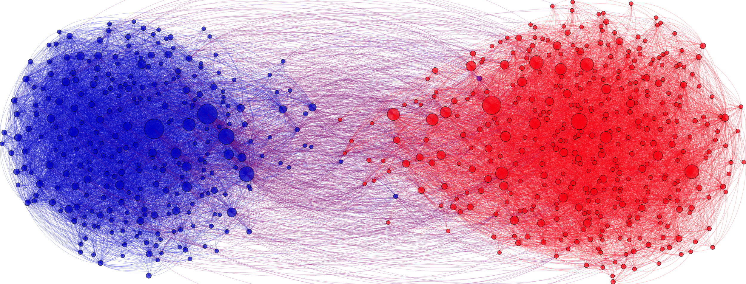
Community Detection Applications
Targeted advertising and market segmentation
Notes:
Homicide Network Detection, Chang Et, Al. https://www.scitepress.org/Papers/2021/105338/105338.pdf
To racketeer among neighbors: spatial features of criminal collaboration in the American Mafia, Andrid Et. Al. https://www.tandfonline.com/doi/abs/10.1080/13658816.2021.1884869?journalCode=tgis20&

Slide 4
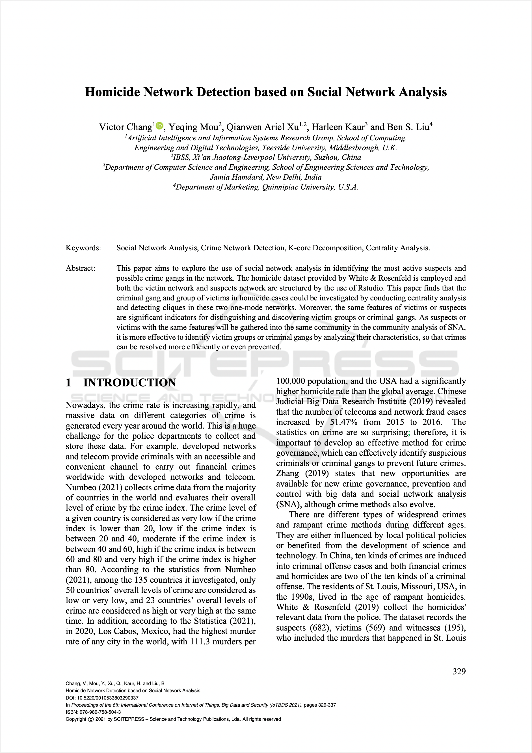
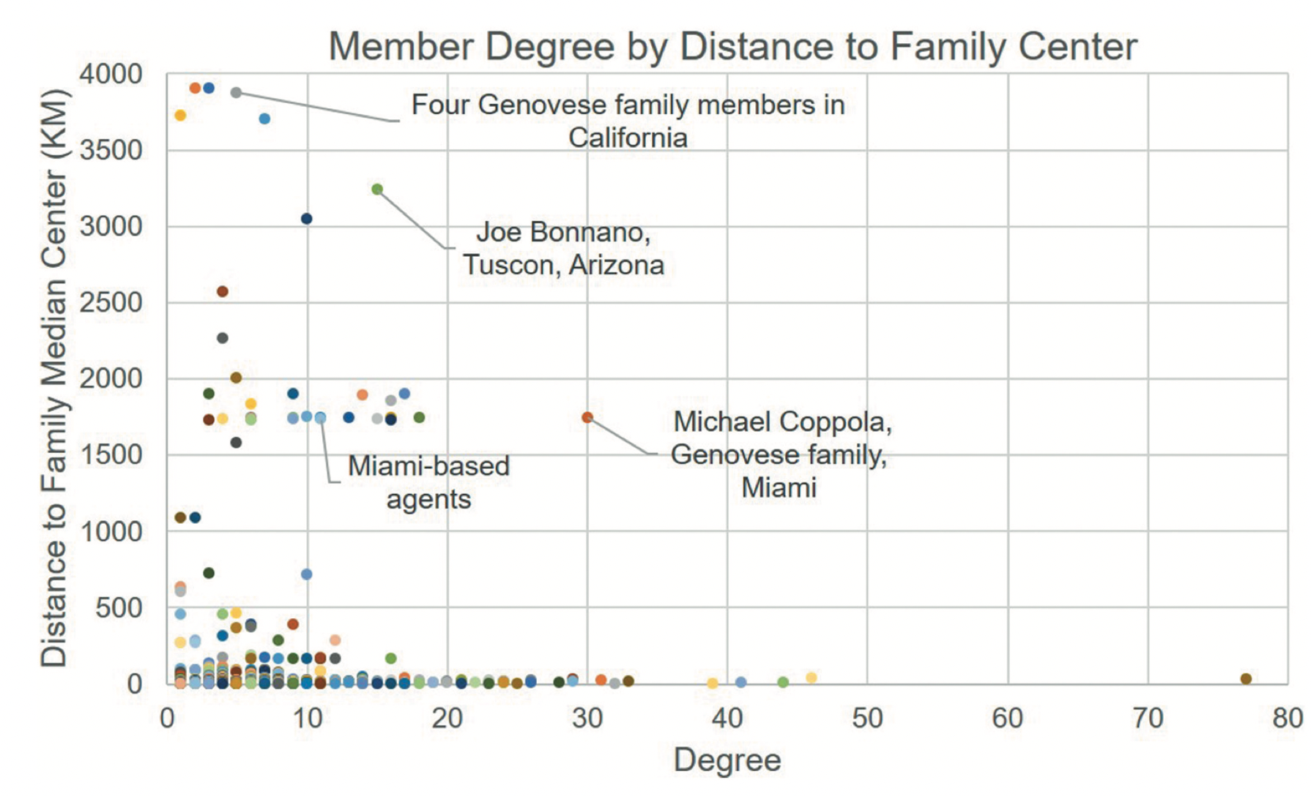
Community Detection Applications
Suspect identification and criminal network modelling
Notes:
Homicide Network Detection, Chang Et, Al. https://www.scitepress.org/Papers/2021/105338/105338.pdf
To racketeer among neighbors: spatial features of criminal collaboration in the American Mafia, Andrid Et. Al. https://www.tandfonline.com/doi/abs/10.1080/13658816.2021.1884869?journalCode=tgis20&

Slide 5
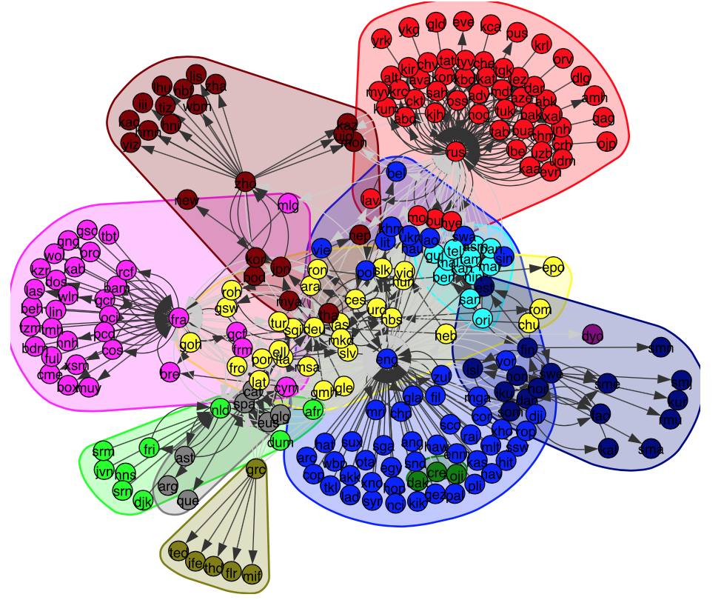
Community Detection Applications
Enterprise resource planning & HR
Co-occurance of languages in multilingual speakers
Notes:
Image: H. Bitten 2019: https://towardsdatascience.com/detecting-communities-in-a-language-co-occurrence-network-f6d9dfc70bab

Slide 6
“Fast” Algorithms
  Network datasets are becoming increasingly large
  Big-O runtime complexity lacks context
    How dense is the network?
    Are well-formed communities expected?
  Implementations vary significantly
  E.g. Girvan-Newman
    In NetworkX, GN relies on Brandes’ O(MN + N² logN) betweenness algorithm
    Newman’s betweenness approach is O(MN), a naïve approach might be O(MN²)

Slide 7
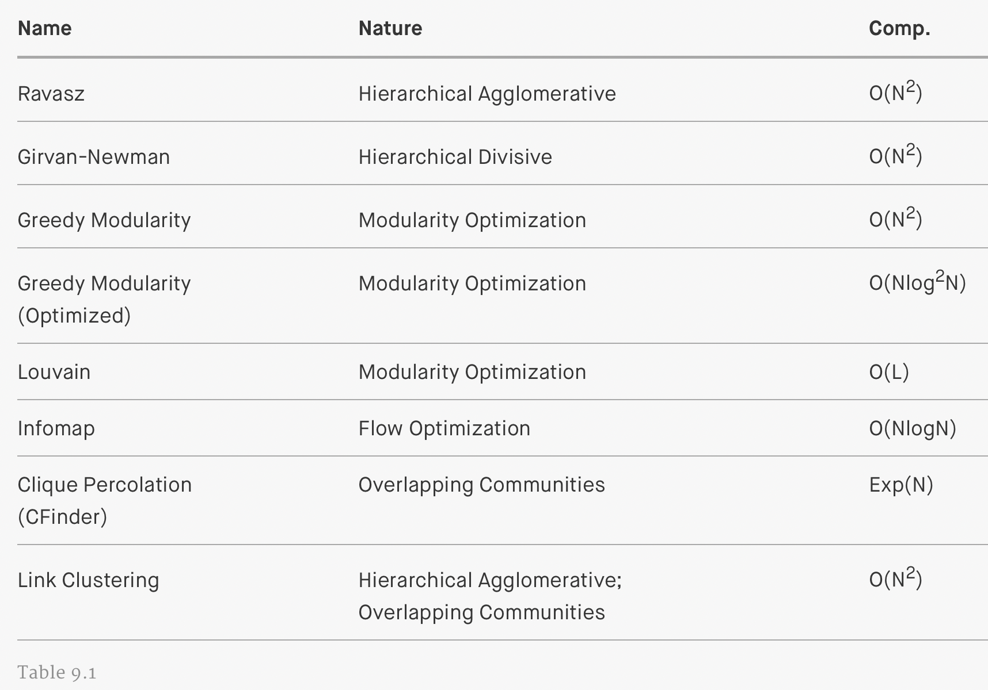
“Fast” Algorithms
  Tables like this can be deceiving
Notes:
Image: http://networksciencebook.com/chapter/9#testing

Slide 8
Fast Algorithms
  Two general-purpose, fast algorithms:
  Infomap
    Martin Rosvall, Carl Bergstrom
  Louvain
    Vincent Blondel, Jean-Loup Guillaume, Renaud Lambiotte, Etienne Lefebvre

Slide 9
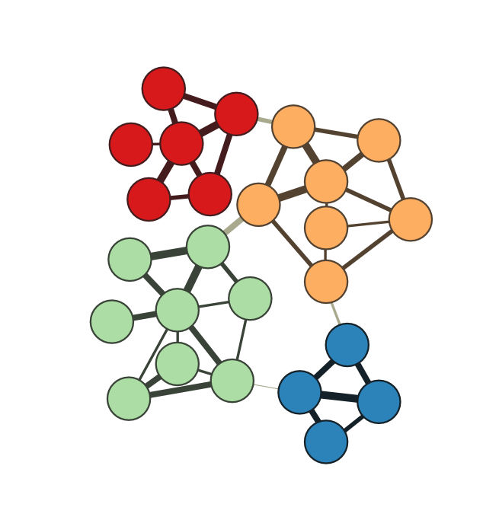
InfoMap
  Leverages data compression methods
  Effectively a measure of flow
    A group of nodes between which have a high degree of flow between them can all reach another node in the graph with approximately the same efficiency.
  Random walk compressibility is used as a proxy for flow

Slide 10
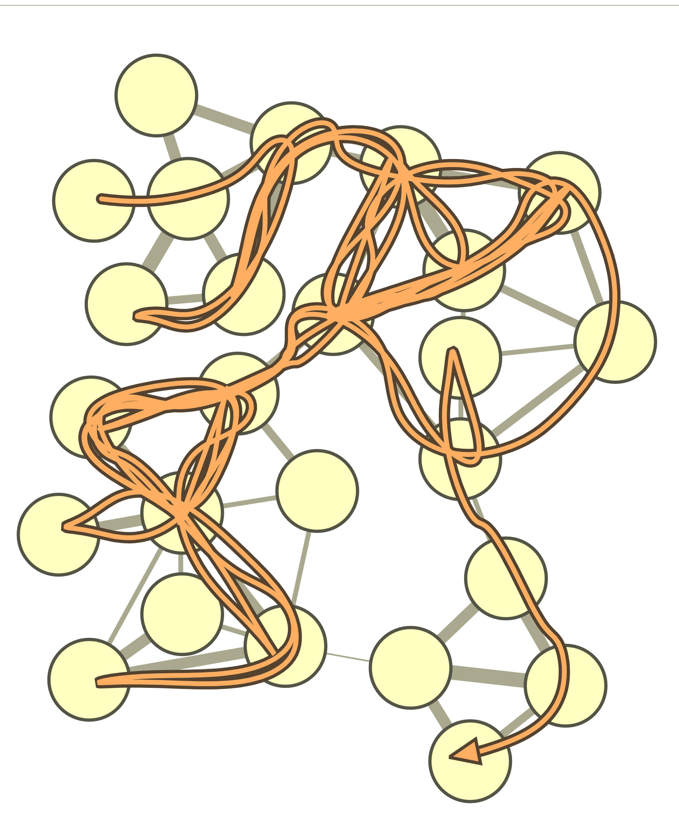
InfoMap - Example
  Produce many random walks of the network
    E.g. a walk of 74 steps

Slide 11
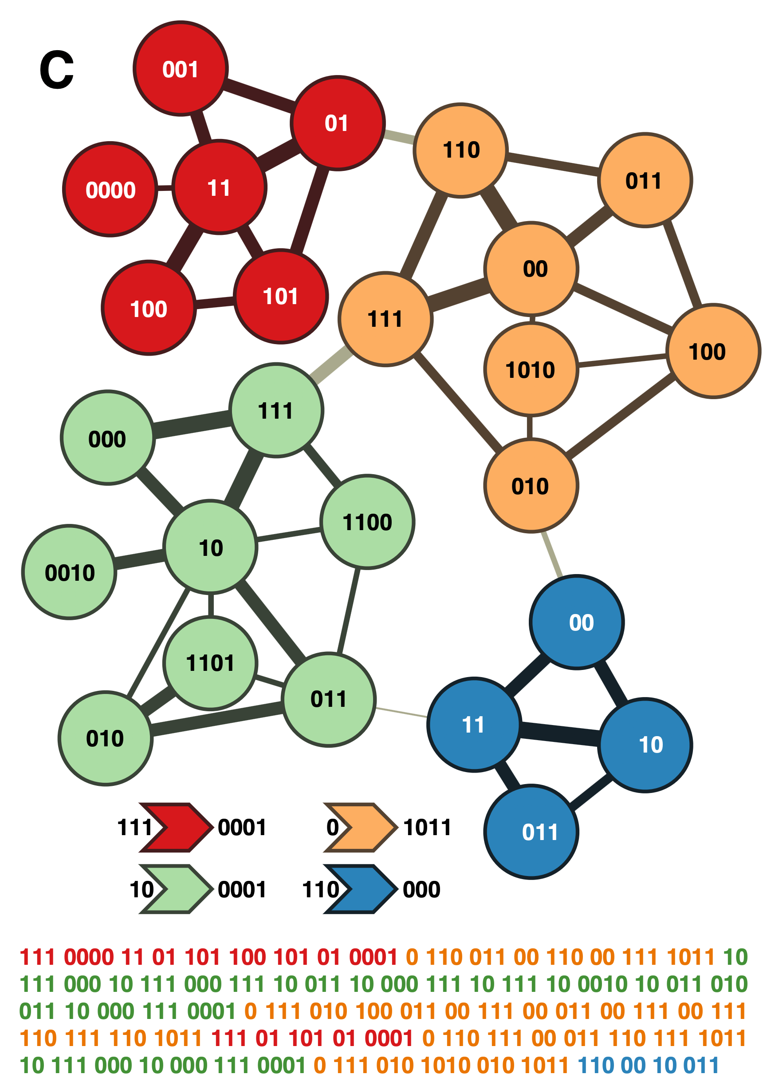
InfoMap - Example
Produce many random walks of the network
  E.g. a walk of 74 steps
Create a “codebooks” with codes representing each community
For each community, produce a codebook labelling each node in that community
Use Huffman encoding to reduce code size
74 steps x 5 chars = 1850 bits
With Infomap: 243 bits

Slide 12
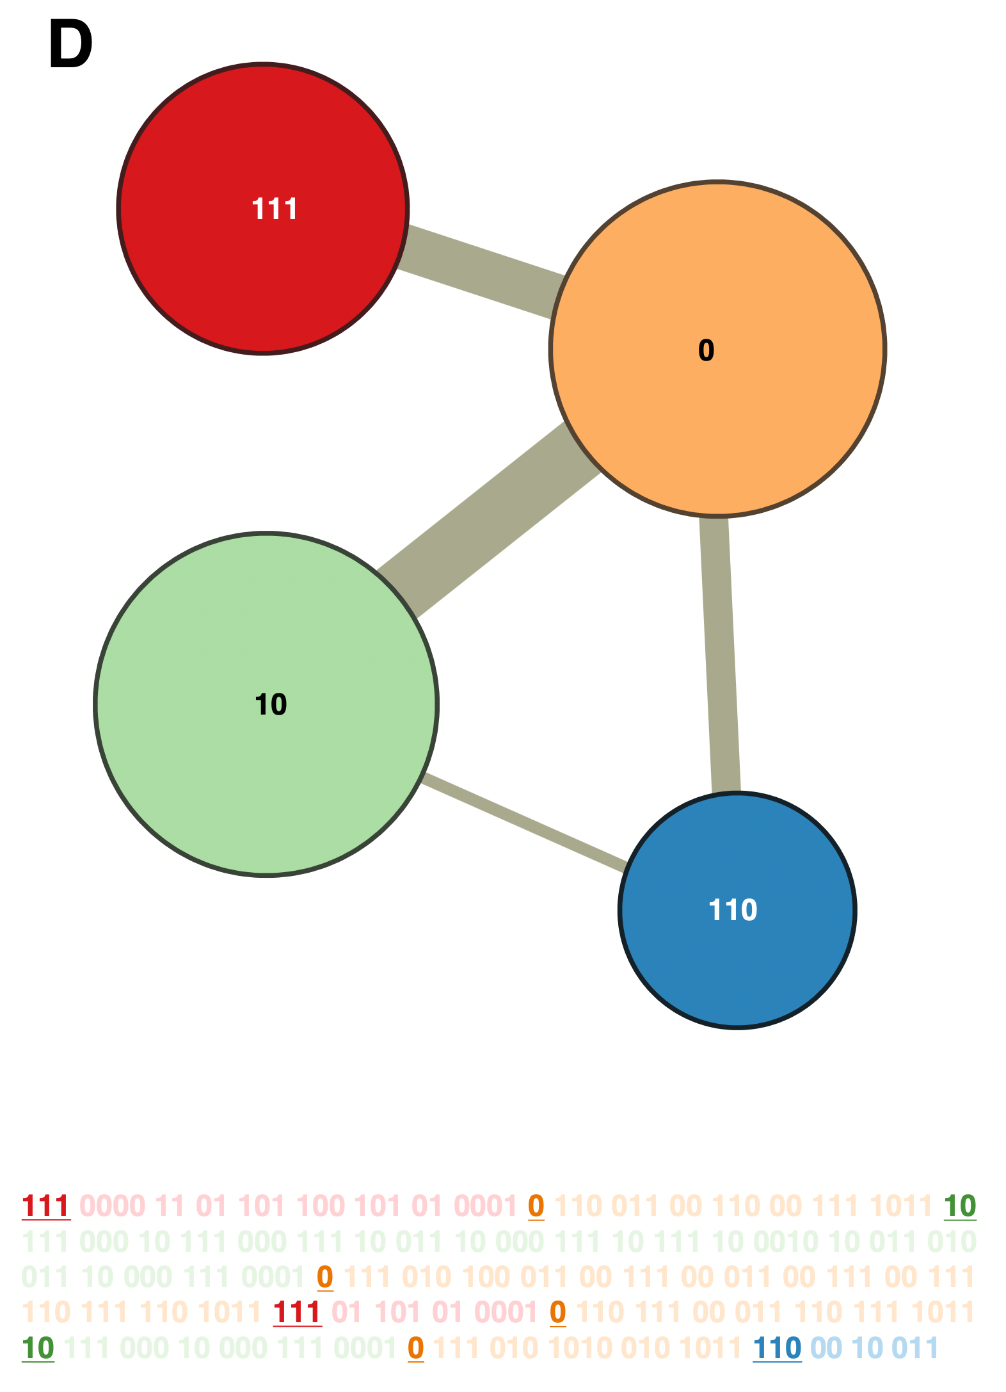
InfoMap - Example
But how do we find the communities?
Start by assigning each node to their own community of one
A) Local Optimization
  Reassign nodes to neighboring communities and observe change in the average compressed path size
  Assign node where it results in the smallest size
B) Aggregation
  Create a new network from the communities found in (A)
  Go back to (A) with the new network and repeat until path size no longer improves
Demo from Martin Rosvall
Notes:
https://umeauniversity-my.sharepoint.com/personal/maro0001_ad_umu_se/_layouts/15/onedrive.aspx?id=%2Fpersonal%2Fmaro0001%5Fad%5Fumu%5Fse%2FDocuments%2FPublic%2FMapDemoScreenRecording%2Emov&parent=%2Fpersonal%2Fmaro0001%5Fad%5Fumu%5Fse%2FDocuments%2FPublic

Slide 13
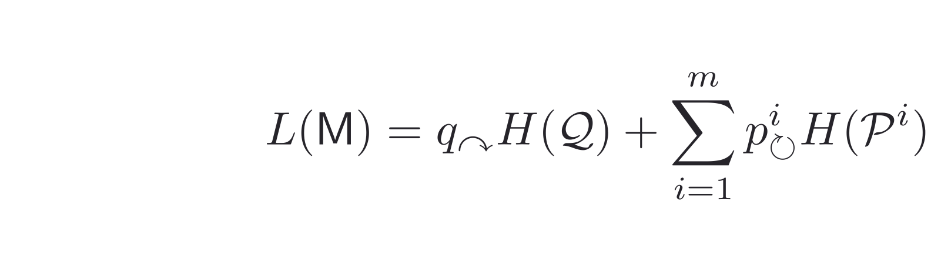
The Map Equation
How do we compute the average compressed path size?
Average number of bits necessary to encode paths between communities
Average number of bits necessary to encode paths within a community

Slide 14
InfoMap
Overall runtime is O(NlogN), can be better for dense networks
Can have resolution issues for small networks, similar to modularity optimizations
Better recognition of networks with no or few communities

Slide 15
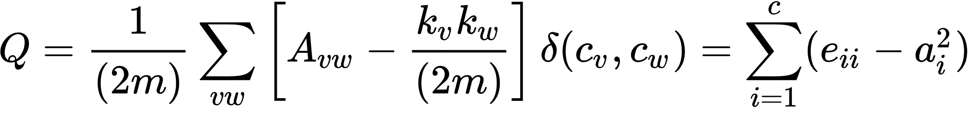
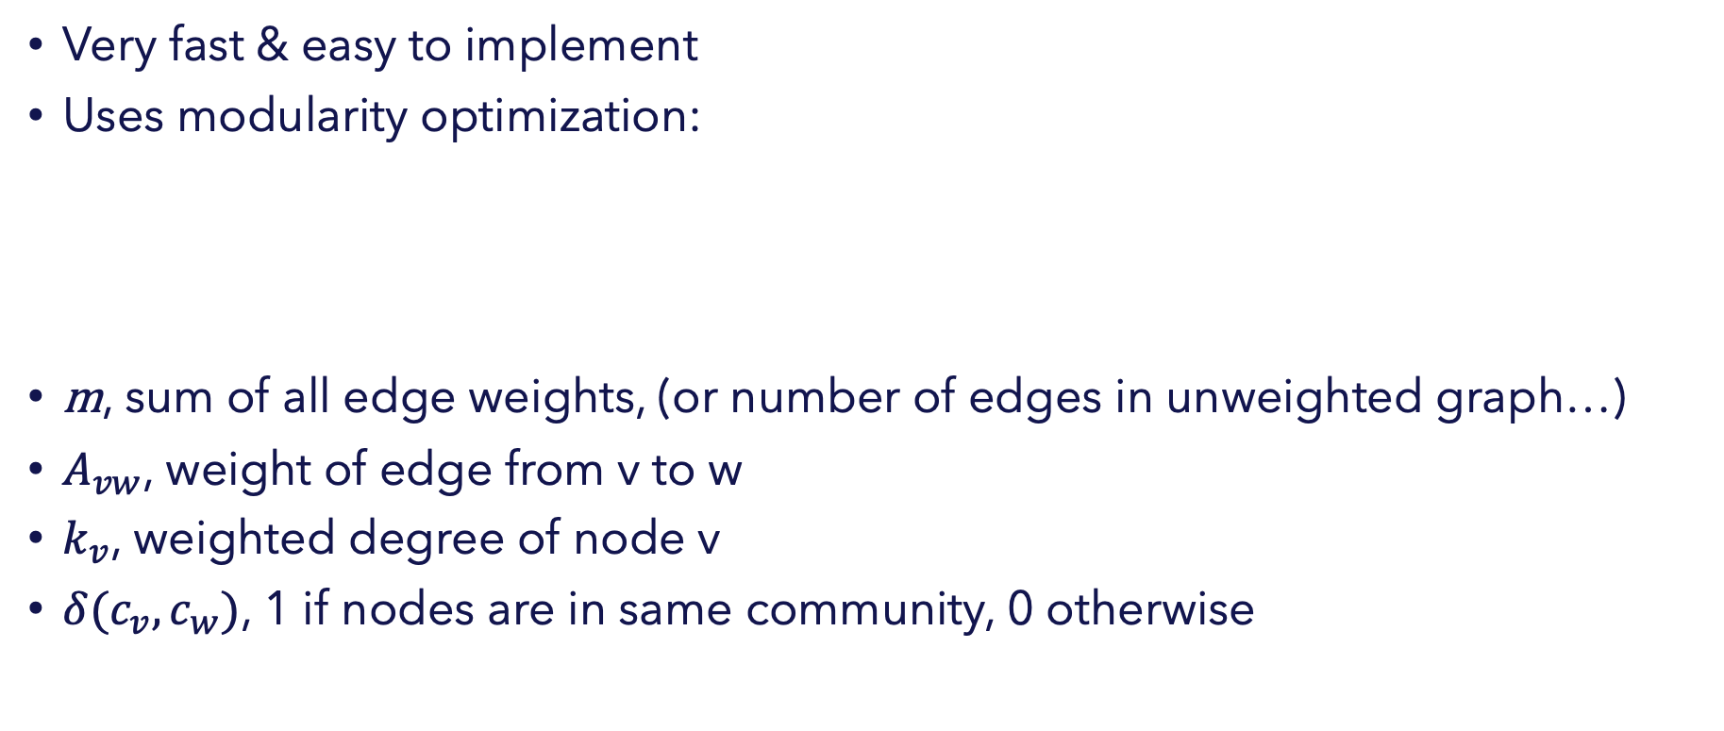
Louvain
Very fast & easy to implement
Uses modularity optimization:
m, sum of all edge weights, (or number of edges in unweighted graph…)
$A_{vw}$, weight of edge from v to w
$k_{v}$, weighted degree of node v
$δ(c_{v},c_{w})$, 1 if nodes are in same community, 0 otherwise
Notes:
Image: https://en.wikipedia.org/wiki/Modularity_(networks)

Slide 16
Louvain
Same optimization procedure as Infomap
Start by assigning each node to their own community of 1
A) Local Optimization
  Reassign nodes to neighboring communities and observe change in modularity
  Assign node where it results in the most positive modularity change
B) Aggregation
  Create a new network from the communities found in (A)
  Go back to (A) with the new network and repeat until modularity no longer improves (convergence)
Finally, label nodes in the original network by which community they ended in
Demo, K. Jolley
Notes:
Demo Video: https://www.youtube.com/watch?v=dGa-TXpoPz8

Slide 17
Louvain
Overall, a very safe choice to begin with
Runs fast: O(NlogN) worst case. More often: proportional to M edges
Louvain is not without issues:
  When to stop optimization?
    For certain configurations, Louvain can take a long time to reach convergence.
    How to know when you’ve reached a desirable level of modularity? What about local maxima?
  Modularity has resolution issues on small graphs
  Can also merge cliques that are better identified as separate communities (Leiden algorithm helps with this)
  Storage and memory are often more limiting than compute time
Notes:
Demo Video: https://www.youtube.com/watch?v=dGa-TXpoPz8

